Slide 1
Beyond Loops: The parallel Construct
SPMD Parallelism
© 2018 L. V. Kale at the University of Illinois Urbana
Notes:
If it has Fortran and C delete Fortran.
If only Fortran then mention it.

Slide 2
parallel for: Restrictions
The number of times that the loop body is executed (trip-count) must be available at runtime before the loop is executed
The loop body must be such that all iterations of the loop are completed
Also, some computations may be parallel, but not expressible easily via parallel loops

Slide 3
The parallel Directive
This allows the programmer to explicitly say what each thread does
This directive tells all the threads to execute the structure block
What is the point of having all threads execute the same code?
Each thread has access to each id and so it can do different work depending on id
Ids are serial numbers from 0 to total number of thread
#pragma omp parallel [clause [clause …]]
structured block

Slide 4
The parallel Directive:
When a parallel directive is encountered, threads are spawned, which execute the code of the enclosed structured block (the parallel region)
The number of threads can be specified just like for the parallel for directive
Each thread executes the code in the enclosed code-block
You can specify private variables as before (but no “lastprivate”)

Slide 5
parallel vs. parallel for
Arbitrary structured blocks v/s loops
Coarse grained v/s fine grained
Replication v/s work division
#pragma omp parallel for
for(i=0; i<10; i++) {
printf(“Hello world\n”);
}
Output: 10 Hello world messages
#pragma omp parallel private(i)
{
for(i=0; i<10; i++) {
printf(“Hello world\n”);
}
}
Output: 10*T Hello world messages
where T = number of threads

Slide 6
A Simple Example with parallel
for( i=0; i<N; i++ ) {
A[i] = x*B[i];
}
#pragma omp parallel for
for( i=0:N; i<N; i++ ) {
A[i] = x*B[i];
}
#pragma omp parallel
{ int id = omp_get_thread_num();
int p = omp_get_num_threads();
int mystart = (N*id)/p;
int myend = (N*(id+1))/p;
if(myend>N) myend = N;
for( i=mystart; i<myend; i++ ) {
A[i] = x*B[i];
}
}
Each thread calculates the range of iterations it’s going to work on using variables mystart and myend after finding out
The total number of threads, p, in its team and
Its own rank, id, within the team

Slide 7
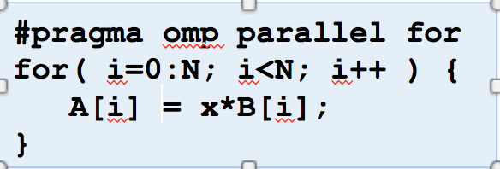
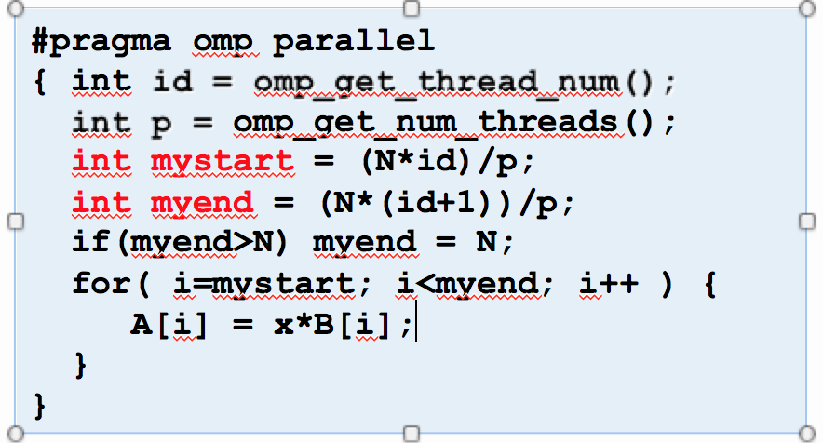
parallel vs. parallel for
The code with parallel is much longer and complicated
But it gives you, the programmer, much greater control
And the cases where you will use it are typically much longer pieces of code
To use the full power of this construct you will also need to use other constructs, particularly synchronization constructs

Slide 8
parallel Construct: Example 2
double x, y;
int i, j, m, n, maxiter, depth[300][200],
dith_depth[300][200], mandel_val();
n = 300; m = 200;
maxiter = 200;
#pragma omp parallel for private(j, x, y)
for (i = 1; i <= m; i++)
for (j = 1; j <= n; j++) {
x = i/ (double) m;
y = j/ (double) n;
depth[j][i] = mandel_val(x, y, maxiter);
}
#pragma omp parallel for private(j)
for (i = 1; i <= m; i++)
for (j = 1; j <= n; j++)
dith_depth[j][i] = 0.5*depth[j][i]
+ 0.25*(depth[j-1][i] + depth[j+1][i])
Parallelizing consecutive for loops requires initializing threads twice!

Slide 9
parallel Construct: Example 2 Rewritten
Rewrite with parallel
double x, y;
int i, j, m, n, maxiter, depth[300][200],
dith_depth[300][200], mandel_val();
n = 300; m = 200;
maxiter = 200;
int id, myfirst, mylast;
omp_set_num_threads(16);
#pragma omp parallel private(id, myfirst, mylast, i, j, x, y)
{
id = omp_get_thread_num();
myfirst = first_idx(id, m, 16);
mylast = last_idx(id, m, 16);
for (i = myfirst; i <= mylast; i++)
for (j = 1; j <= n; j++) {
x = i/ (double) m;
y = j/ (double) n;
depth[j][i] = mandel_val(x, y, maxiter);
}
for (i = myfirst; i <= mylast; i++)
for (j = 1; j <= n; j++)
dith_depth[j][i] = 0.5*depth[j][i]
+ 0.25*(depth[j-1][i] + depth[j+1][i]);
}
Threads are forked once and then work independently

